Slide 1
IBM University Engagement Project Submission
“Exploring the Power of Agentic AI with IBM Granite and LangFlow”

Slide 2

Project Tile – [NutriAI – An AI‑Powered Personalized Nutrition Assistant]
Domain of Project – [Digital Health & Nutrition ]
Student Name | Recent Passport Photo | Email ID | Mobile number [WhatsApp]
VASUDEV JANGID |  | jangidvasudev03@gmail.com | 9021828637
Recommended font style and size: Font Style: Arial Font Size (Heading): 28
Font Size (Content): 20

Slide 3
Problem Statement -
Fragmented information – Reliable nutrition data (calories, macro‑/micronutrients, disease‑specific recommendations) is scattered across many websites, making it hard for users to find trustworthy facts.
Lack of personalization – Generic diet plans ignore age, medical conditions, allergies, cultural food preferences, and individual fitness goals.
Difficulty in tracking – Manual food journaling is time‑consuming; users cannot quickly see how a meal fits into their daily nutrient targets.
Preventive nutrition gap – People with chronic conditions (diabetes, hypertension, cardiovascular disease) need diet guidance that aligns with medical recommendations, but few tools provide clinically‑vetted, real‑time advice.

Slide 4
Proposed Solution -
A modular, multi‑agent AI platform (NutriAI) that:
Collects user profile – age, gender, weight, height, activity level, health conditions, allergies, cultural/culinary preferences, and specific goals (weight loss, muscle gain, disease management).
Generates personalized meal plans – daily/weekly menus with recipes, portion sizes, and grocery lists, respecting the user’s constraints.
Retrieves verified nutrition facts – via a Retrieval‑Augmented Generation (RAG) pipeline that pulls data from USDA FoodData Central, EFSA, peer‑reviewed journals, and accredited clinical guidelines.
Enables multimodal food logging – users can type, upload a photo, or speak a description; the system uses OCR & image‑recognition models to identify foods, estimate portions, and compute calories/macros/micronutrients.
Provides instant feedback – compares logged intake against personalized targets, flags excesses/deficiencies, and suggests corrective actions (e.g., “Add a serving of leafy greens to reach your vitamin K goal”).
Delivers preventive health advice – tailored diet suggestions for diabetes, hypertension, dyslipidemia, gut health, etc., grounded in clinical guidelines (ADA, AHA, DASH, Mediterranean diet).
Visual Dashboard – interactive charts (daily/weekly nutrient distribution, trend lines for weight/BMI, compliance score) and alerts for upcoming deficiencies.
All agents work together through IBM Orchestrate to route requests, maintain context, and ensure a seamless user experience.

Slide 5
Technology Used
Layer | Technology | Role
Workflow & Orchestration | IBM LangFlow (graphical flow builder) + IBM Orchestrate | Design and manage the multi‑agent pipelines, state handling, and external API calls.
LLM Core | IBM Granite / IBM Watsonx.ai (instruction‑tuned LLM) | Natural‑language understanding, plan generation, conversational responses.
Retrieval‑Augmented Generation | IBM Knowledge Studio + Vector DB (e.g., Milvus/IBM Cloud Vector Search) | Indexes nutrition datasets (USDA, EFSA, clinical guidelines); retrieves relevant facts for the Nutrition Knowledge Agent.
Image & Speech Processing | IBM Visual Recognition (food‑image classification) + IBM Speech‑to‑Text | Convert photos or voice logs into structured food‑item lists and portion estimates.
Data Sources | USDA FoodData Central, EFSA, WHO nutrient recommendations, ADA/AHA clinical guidelines, peer‑reviewed nutrition journals (via CrossRef API) | Authoritative nutrition facts and disease‑specific diet rules.
Frontend / Dashboard | IBM Cloud Pak for Data (Dash/Plotly), React UI, IBM Cloud Object Storage for user logs | Interactive visualizations, progress tracking, and meal‑plan export.
Security & Compliance | IBM Security Verify, HIPAA‑compatible data storage | Protect personal health information.

Slide 6
Langflow component Used -
Agent | Core Responsibility | How Agentic AI Enables It
Nutrition Knowledge Agent | Retrieves and summarizes up‑to‑date nutrient values & clinical diet rules. | Uses RAG to query the vector store, then the LLM to synthesize concise answers.
Diet Recommendation Agent | Crafts personalized meal plans and grocery lists. | Takes the user profile, applies constraint‑solving logic, and generates natural‑language recipes.
Health Advisory Agent | Provides disease‑specific preventive diet guidance. | Interprets medical conditions, maps them to guideline‑based recommendations, and produces actionable tips.
Food Log & Feedback Agent | Analyzes logged meals, computes nutrient totals, and gives real‑time feedback. | Combines OCR/image recognition output with the nutrition database; the LLM explains deviations and suggestions.
Orchestrator (Meta‑Agent) | Routes user inputs to the appropriate sub‑agent, maintains session context, and merges multi‑modal outputs. | Ensures seamless hand‑off, tracks state (e.g., current day’s nutrient budget), and resolves conflicts.

Slide 7
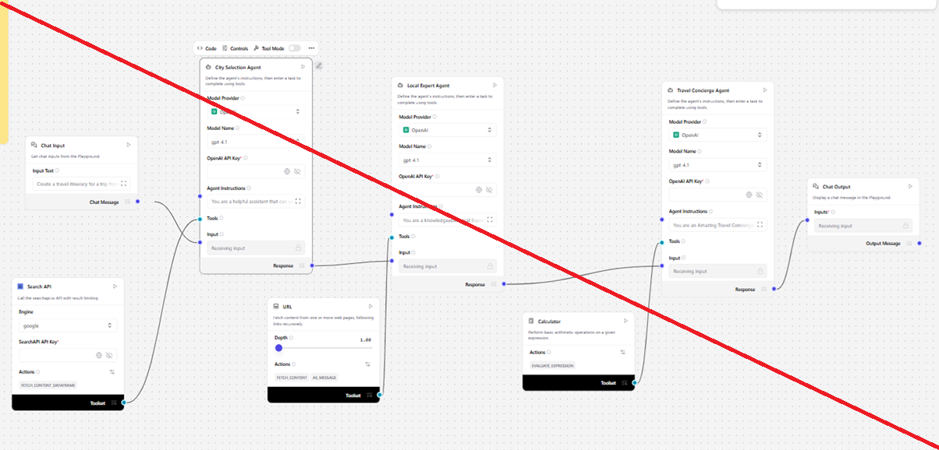
Langflow workflow -

Slide 8

Architecture blueprint

Slide 9

Role of Agentic AI in the solution
NutriAI uses an agentic AI architecture where four specialized agents work together under a meta‑orchestrator: the Nutrition Knowledge Agent retrieves verified nutrient data and clinical guidelines via RAG; the Diet Recommendation Agent creates personalized meal plans based on the user’s profile and the retrieved facts; the Health Advisory Agent adds disease‑specific diet advice (e.g., ADA, DASH) and checks for conflicts; and the Food‑Log & Feedback Agent processes text, photo, or voice entries, matches foods to the knowledge base, calculates real‑time nutrient totals, and gives actionable feedback. IBM Orchestrate maintains context, routes intents, and reconciles outputs, giving NutriAI high accuracy, scalability, and instant, personalized nutrition guidance.

Slide 10


Token Usage
11,761 token are used
Before Prompt
After the Prompt
·
·
·

Slide 11
Novelty and Uniqueness
Full‑stack multimodal logging (text + photo + voice) with automatic portion estimation – rare in consumer nutrition apps.
Hybrid RAG + Clinical Guideline engine – guarantees that every fact comes from a vetted source, reducing misinformation.
Agentic orchestration – distinct specialized agents that communicate via IBM Orchestrate, enabling scalability and easy addition of new health modules (e.g., sports‑performance, prenatal nutrition).
Cultural & Preference Sensitivity – the Diet Recommendation Agent incorporates cuisine taxonomy and user‑provided “favorite foods,” producing culturally relevant meal plans.
Real‑time preventive health feedback – not just calorie counting; the system proactively flags diet‑related risk factors for chronic disease management.

Slide 12
Git Hub Link
Github URL –https://github.com/jangidvasudev03-coder
The Files Uploaded on Github repository 1) app.json file ,
2) yourproblemstatement.pdf file
3) your projectpresntation.pptx file
4)any other files

Slide 13
Future Scope
1.Integration with Wearables & Health Devices –
The system can be integrated with smartwatches and fitness trackers to collect real-time data such as steps, calories burned, heart rate, and sleep patterns. This will enable the Nutrition Agent to provide more accurate and dynamic diet recommendations based on actual user activity and health metrics.
2.AI-Powered Voice Assistant & Multilingual Support –
Enhancing the system with a voice-enabled assistant and support for multiple languages will improve accessibility. Users can interact naturally in their preferred language, making the solution more inclusive and suitable for diverse populations, especially in regions with varied linguistic backgrounds.
·
·
·

Slide 14
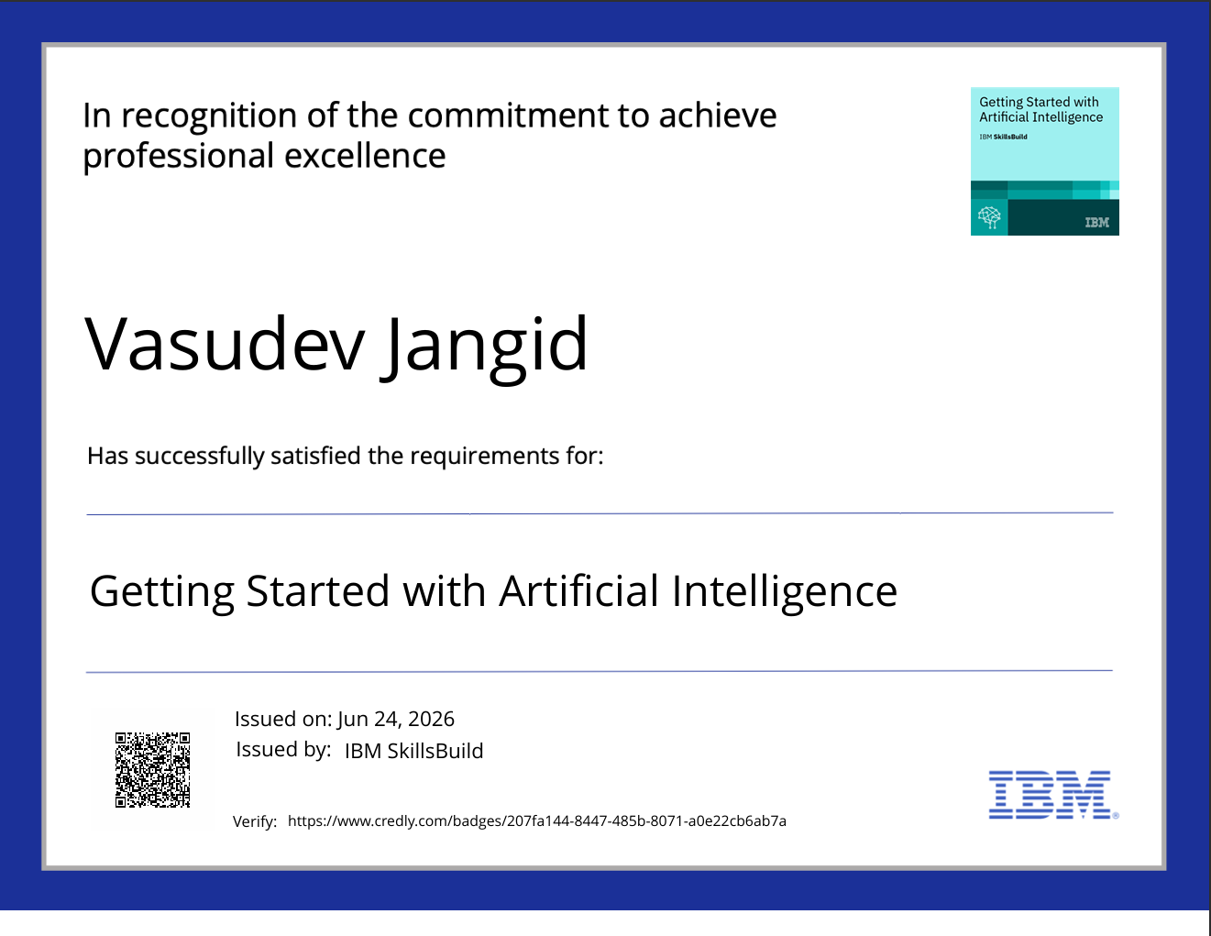
Certificates Earned:
Please add your credly certificate

Slide 15
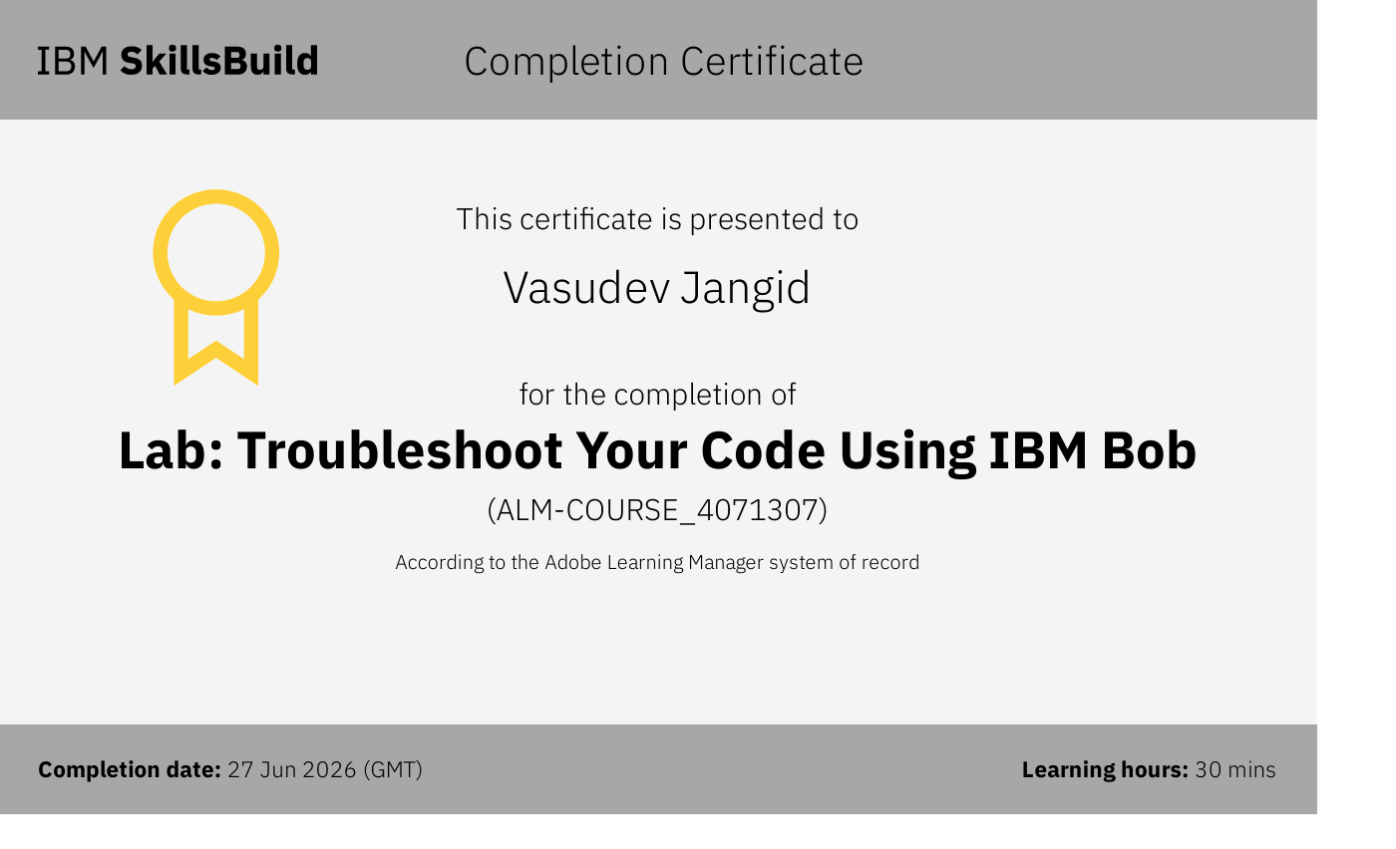
Certificates Earned:​
Add your IBM BOB Certificate

Slide 16


